Slide 1
DEEPFAKE DETECTION USING DEEP LEARNING
GUIDE NAME : GURUNATHAN M
DR.L.SAIRAMESH ROLL NO : 2019202015
MCA(REGULAR)

Slide 2
Dataset Details
DeepFake DetectionBalanced dataset contains 50% real and 50% Fake Videos.
Totally 3200 videos present.
https://www.kaggle.com/c/deepfake-detection-challenge/data

Slide 3
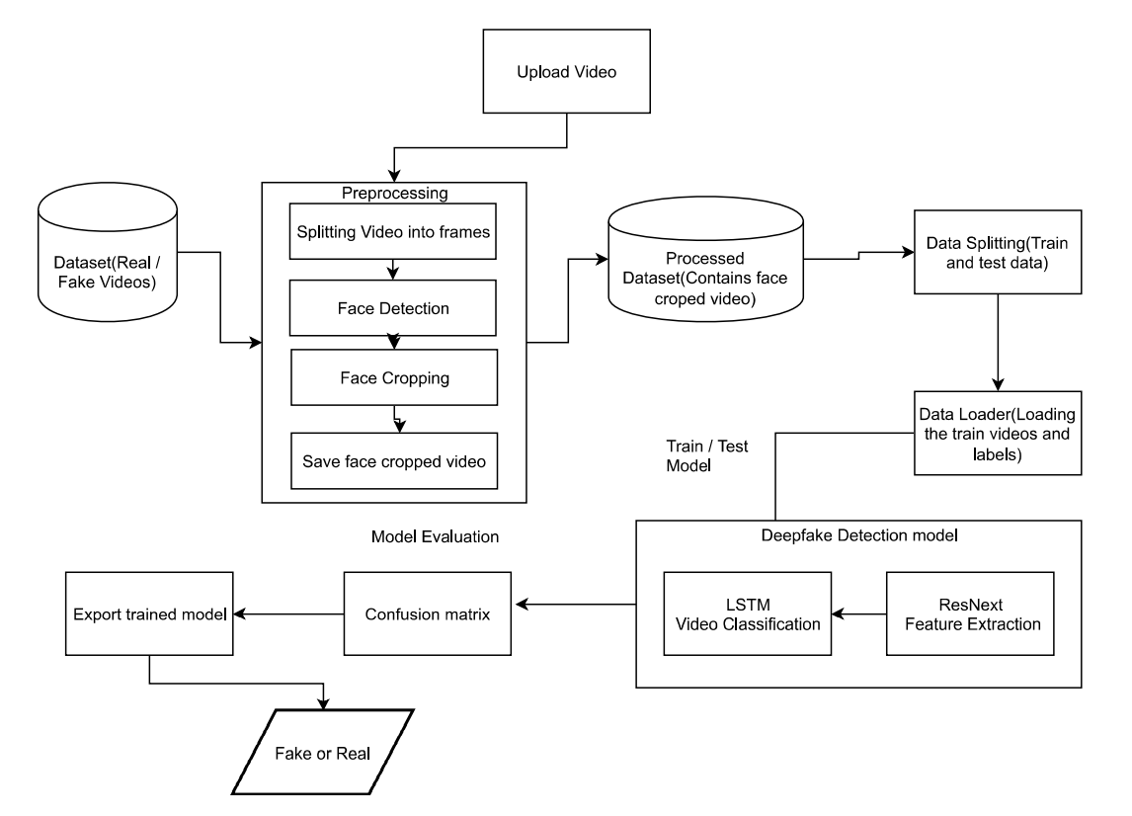
Architecture Diagram:

Slide 4
LIST OF MODULES
Video Preprocessing
Splitting Videos into Frames
Face Detection
Face Cropping
Create Face Cropped Video

Slide 5
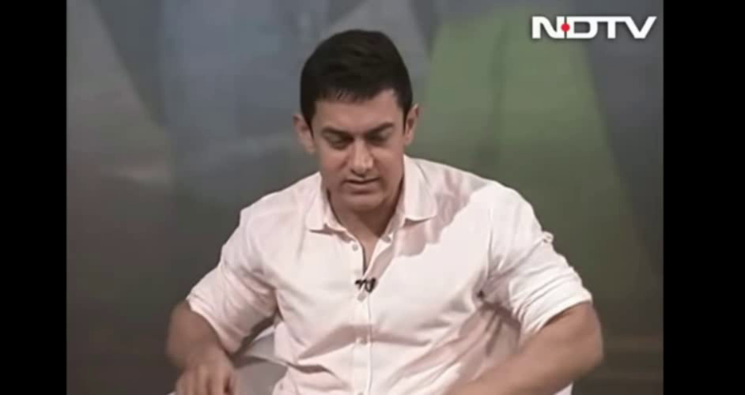
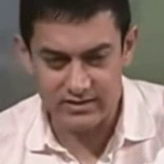
1. Video Preprocessing
Split video into frames
Face Detection
Face Cropping
Input Video
Output Video

Slide 6
1. Video Preprocessing
Using glob we can import all the videos from the directory.
Cv2.VideoCapture is used to read the video.
The video is split into frames and frames are cropped on face location.
The face cropped frames are again written to new video using VideoWriter.
The new video is written at 30 frames per second and with the resolution of 112*112 pixels in the mp4 format.

Slide 7
2. Feature Extraction
Convert the frame images to tensor based on RGB Colour.
ResNext CNN classifier for accurately detecting the frame level features.
Following, we will be fine-tuning the network by adding extra required layers.
The 2048-dimensional feature vectors after the last pooling layers are then used as the sequential LSTM input.

Slide 8
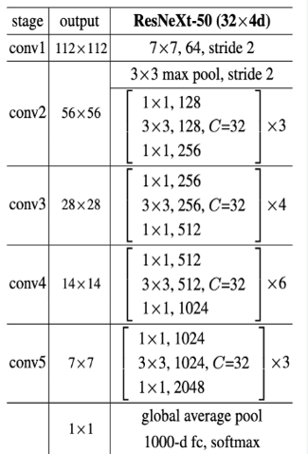
ResNext-50 Architecture
ResNext50 is the Convolutional neural network which is 50 layers deep.
This will take the input image as 112*112 resolution.
Then the image will be processed in all 50 layers.
Output Vector size of the model is 2048.

Slide 9
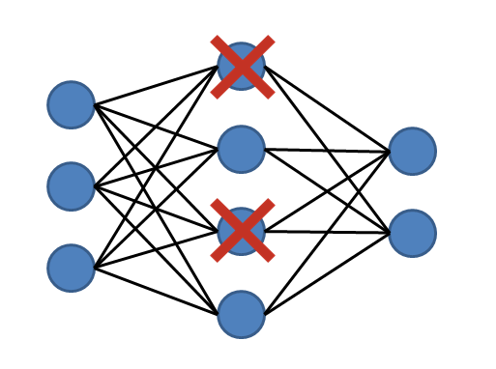
DROPOUT LAYER
Dropout Layer with the value of 0.4 is used to avoid overfitting in the model.
It will deactivate 40% of the neuron in the hidden layer.

Slide 10
3. Sequence Processing
ResNext CNN feature vectors of frames as input for the 2048 LSTM unit, which is capable to do achieve our objective.
LSTM is used to process the frames in a sequential manner
So that the temporal analysis of the video can be made, by comparing the frame at ‘t’ second with the frame of ‘t-n’ seconds.

Slide 11
Feature Extraction & Sequence Processing
Linear layer
Average Pooling layer
Softmax
LSTM
ResNeXt50
Real
Fake
112*112
Image
2048
Units
2048
Units

Slide 12
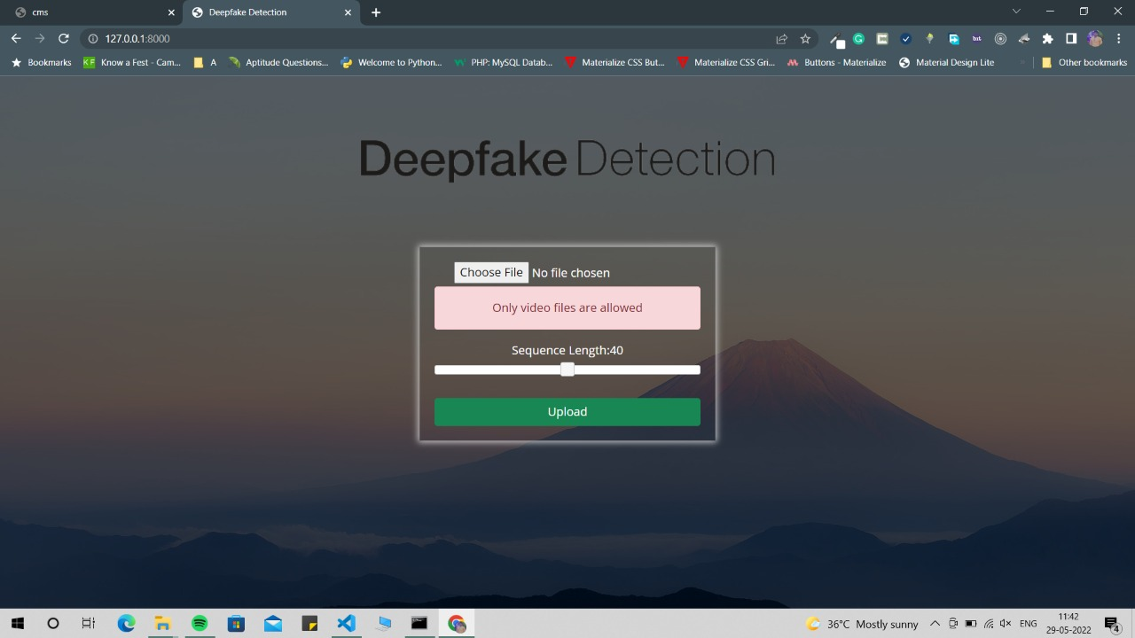
Testcases
Upload a PDF file instead of video
Output :
Only video files are
allowed

Slide 13
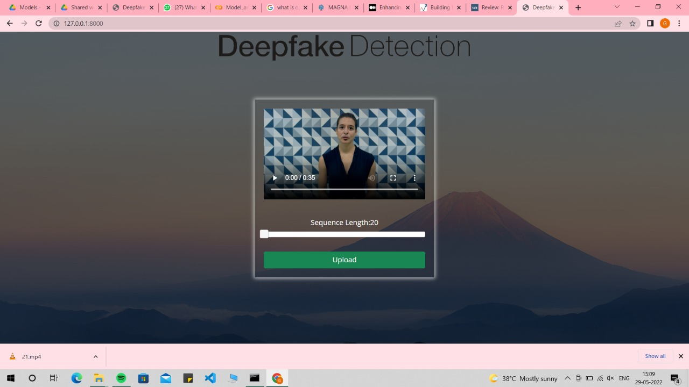
Testcases
2. Upload more than 100 MB Video file

Slide 14
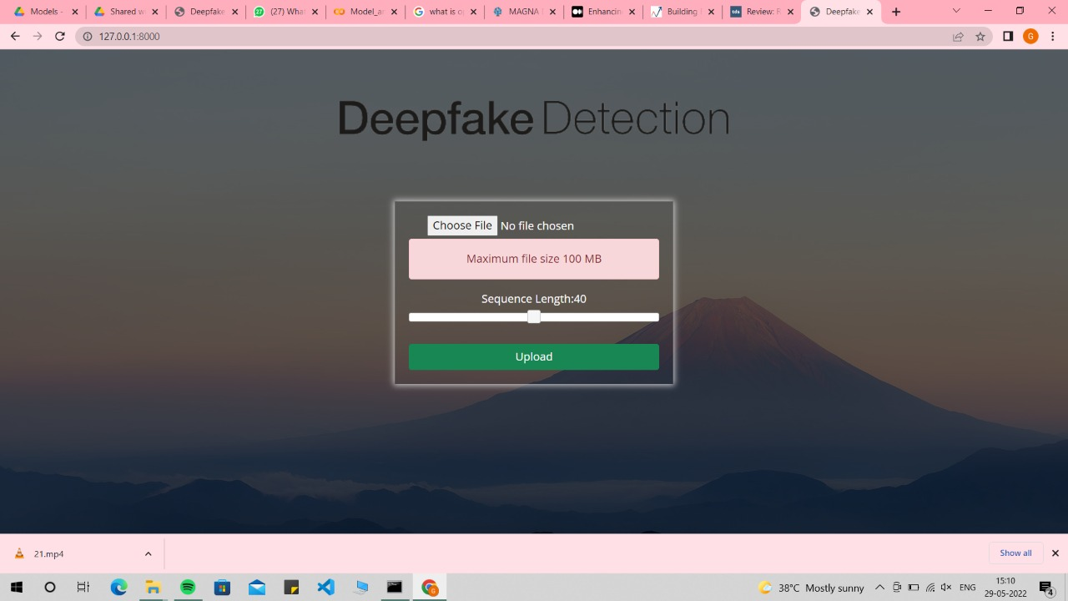
Testcases
2. Upload more than 100 MB Video file
Output :
Maximum file size
is 100 MB

Slide 15
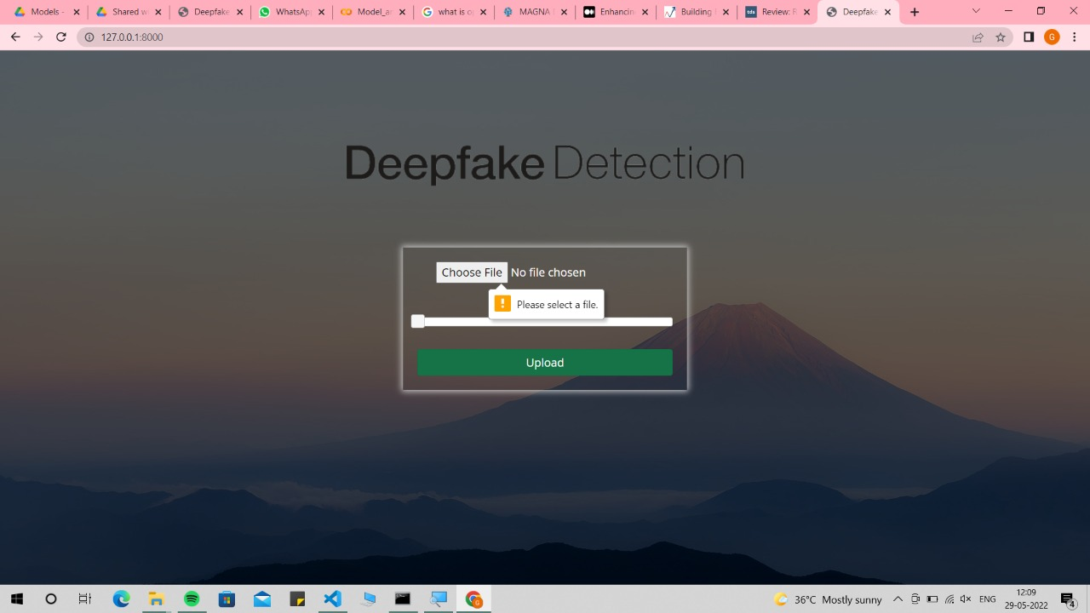
Testcases
3. Press Upload button without selecting video
Output :
Please select a file

Slide 16
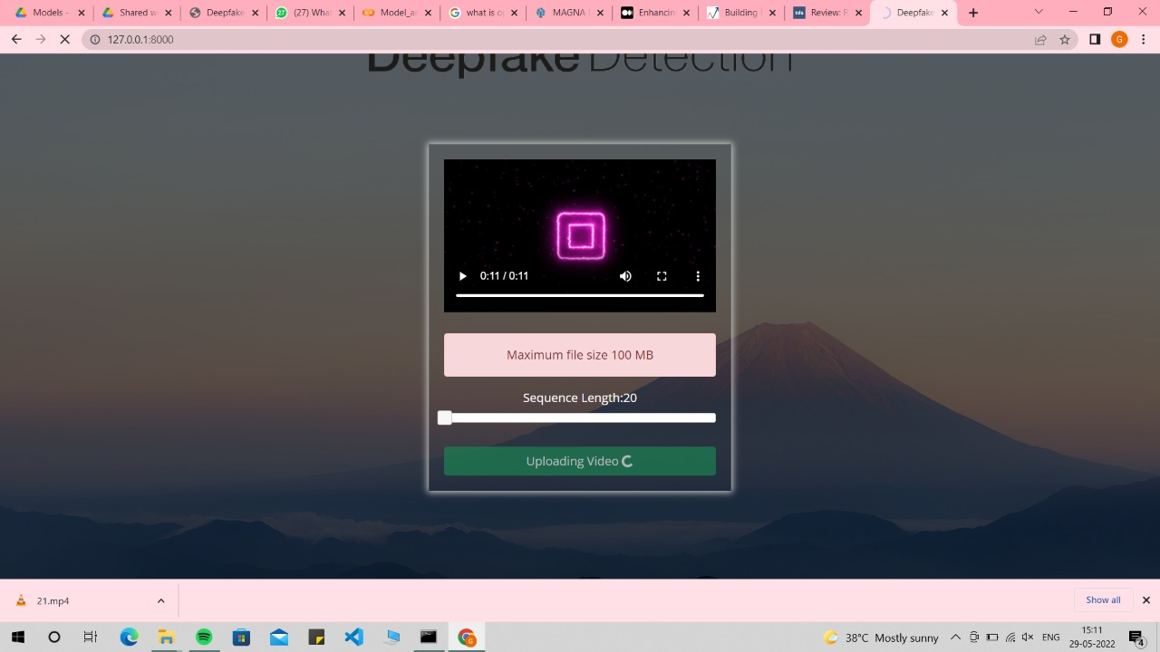
Testcases
4. Upload a file without any faces

Slide 17
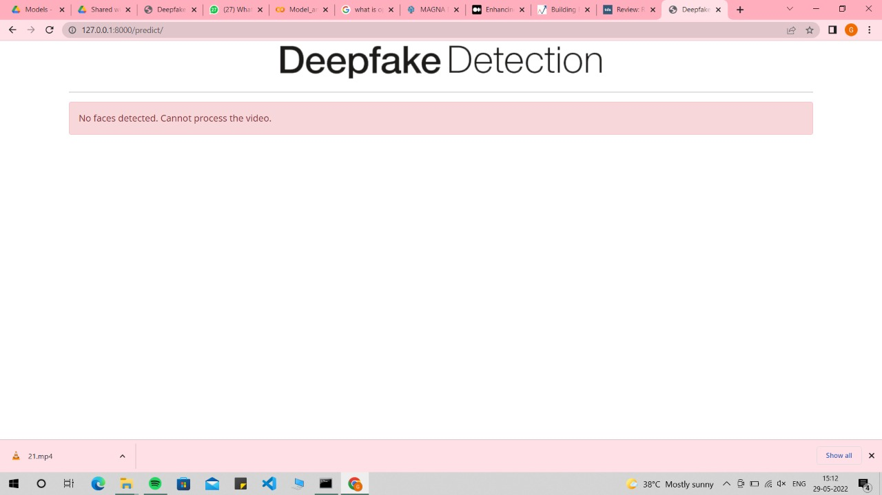
Testcases
4. Upload a file without any faces
Output :
No face detected.

Slide 18
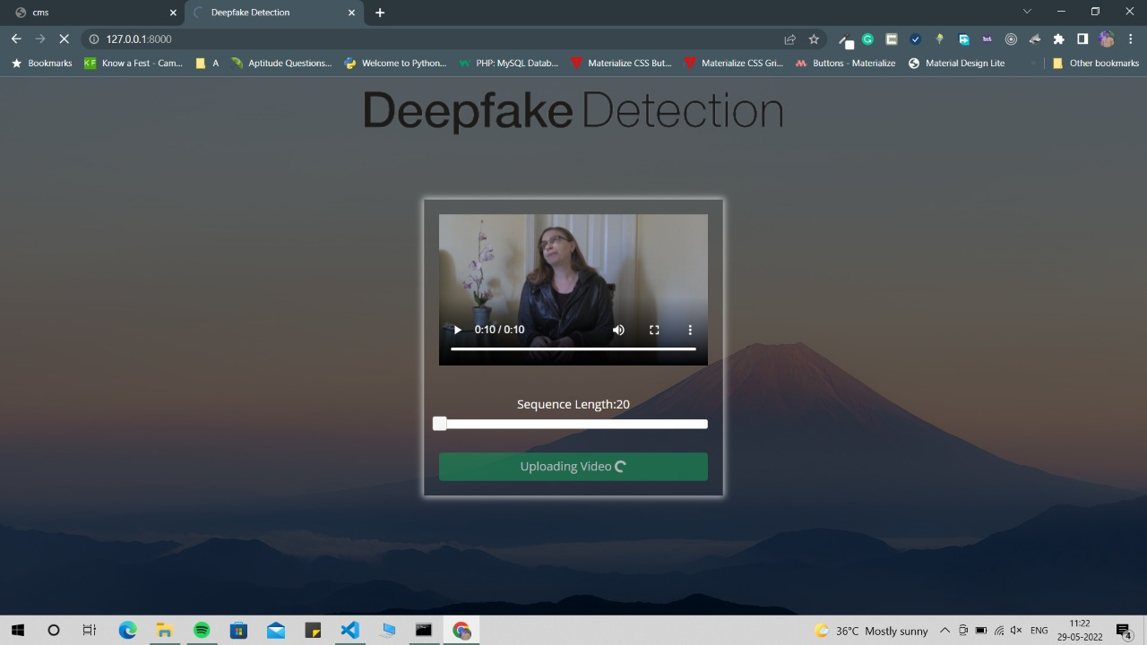
Testcases
5. Upload a Fake Video with 20 Frames

Slide 19
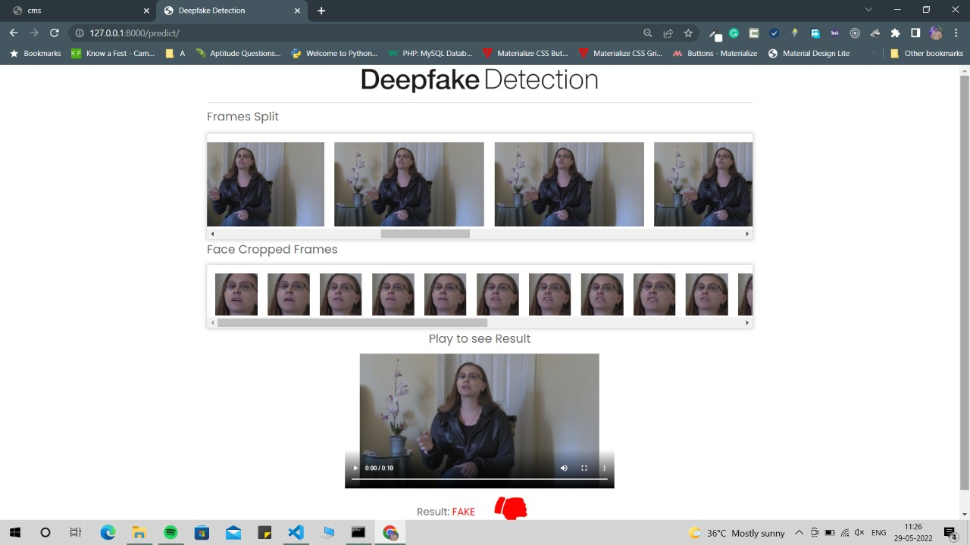
Testcases
5. Upload a Fake Video
Output :
Fake

Slide 20
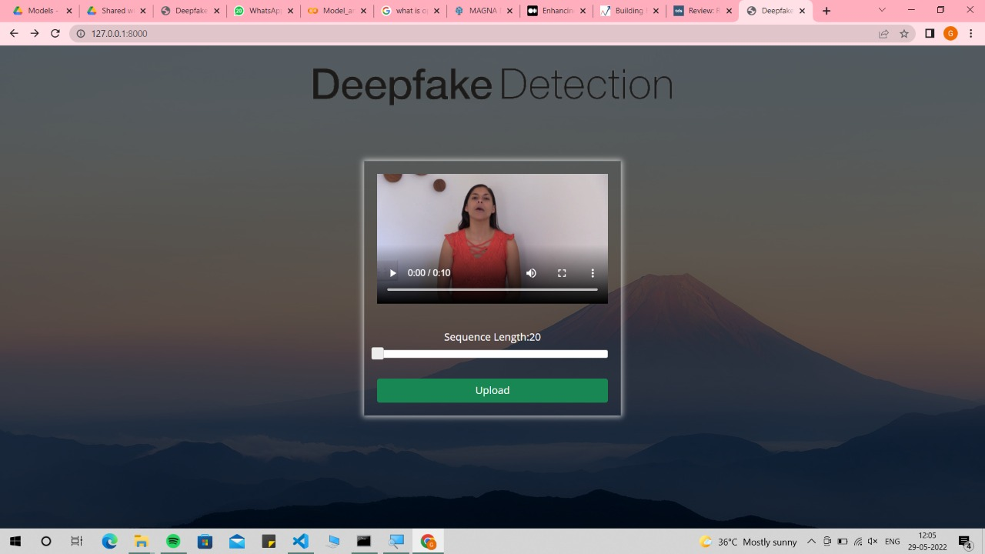
Testcases
6. Upload a Real Video

Slide 21
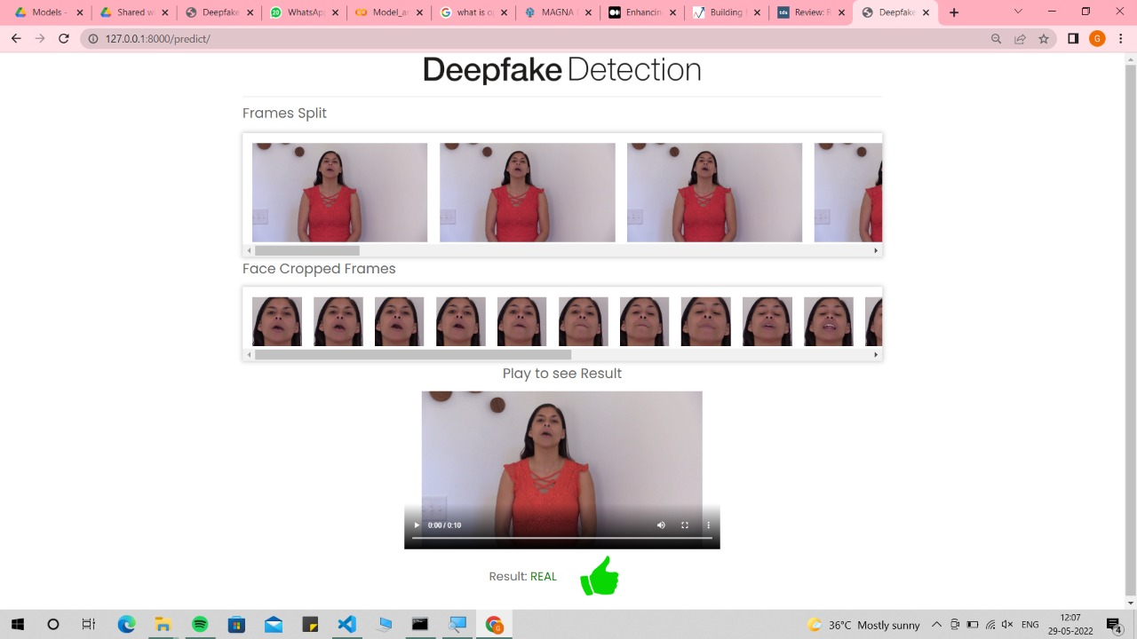
Testcases
6. Upload a Real Video
Output :
Real

Slide 22
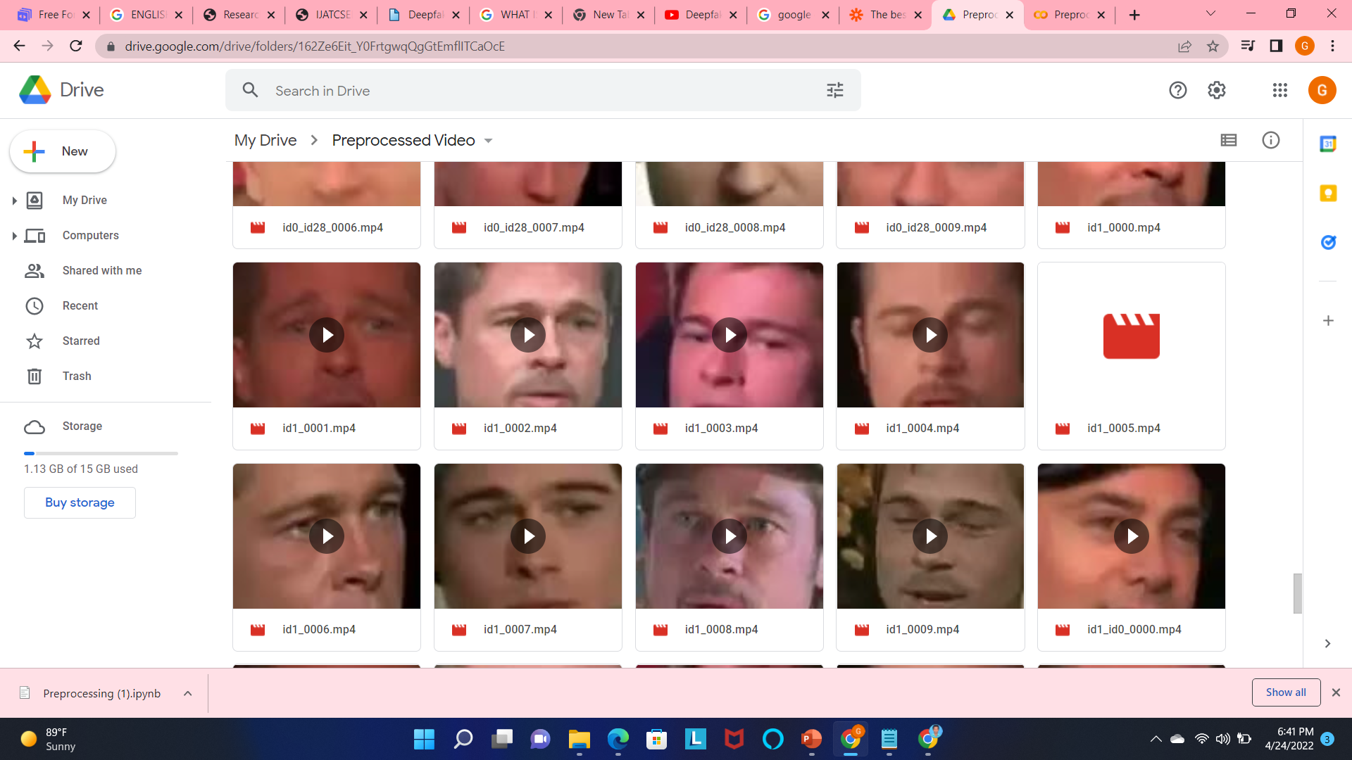
EXPERIMENTAL RESULTS Preprocessing Results

Slide 23
Training and Testing Results
40 Frames model gives better Accuracy rather than other models.
Model Name | Frames | Training Time | Loss | Accuracy
ResNext50 | 20 | 4 Hours | 0.3490 | 89.77
ResNext50 | 30 | 6 Hours | 0.3403 | 90.84
ResNext50 | 40 | 7.5 Hours | 0.3138 | 91.30

Slide 24
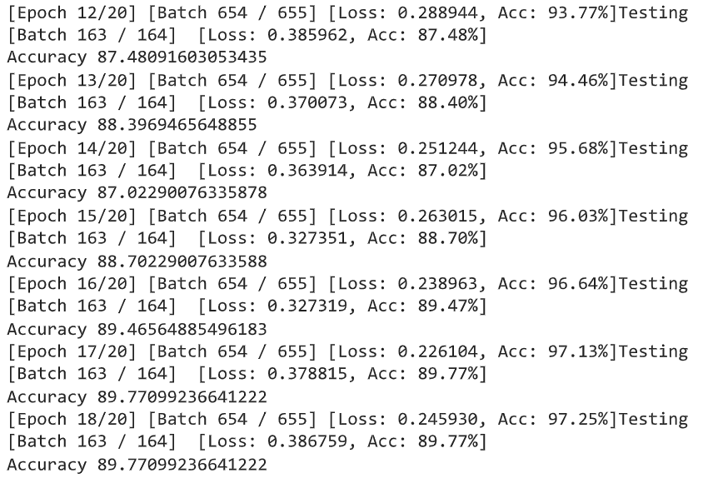
Result of 20 Frames model
Training and Testing Results

Slide 25
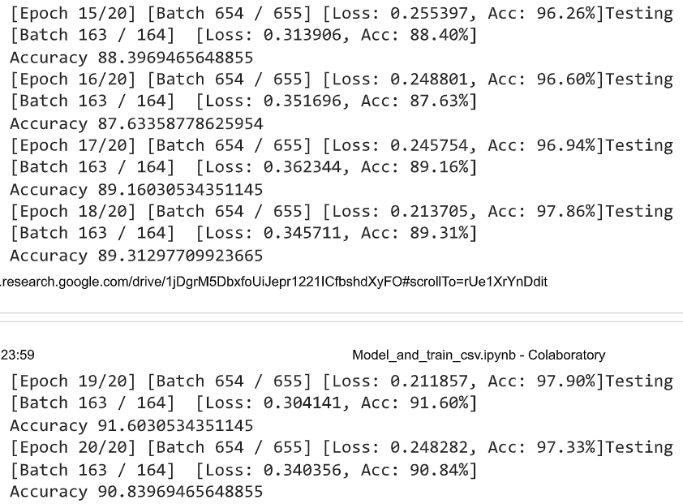
Result of 30 Frames model
Training and Testing Results

Slide 26
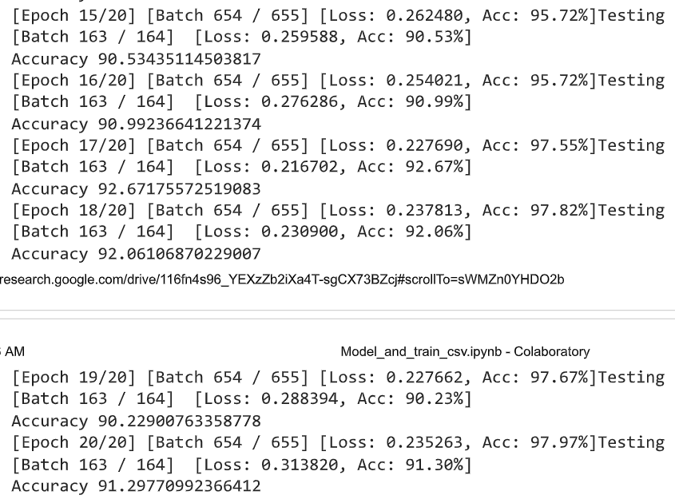
Result of 40 Frames model
Training and Testing Results

Slide 27
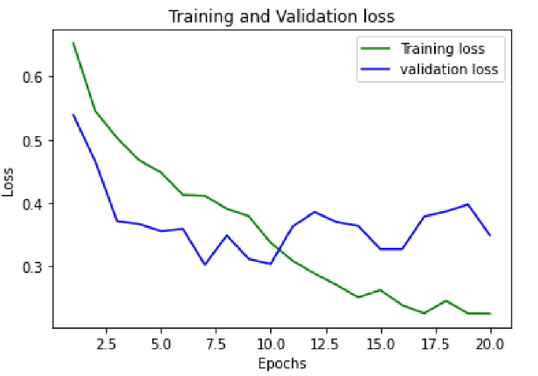
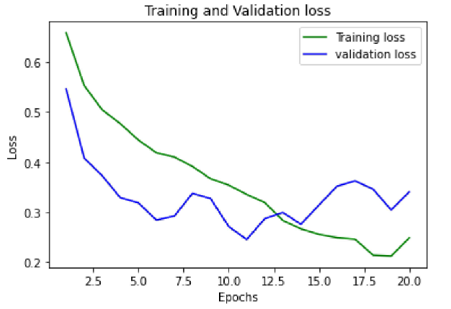
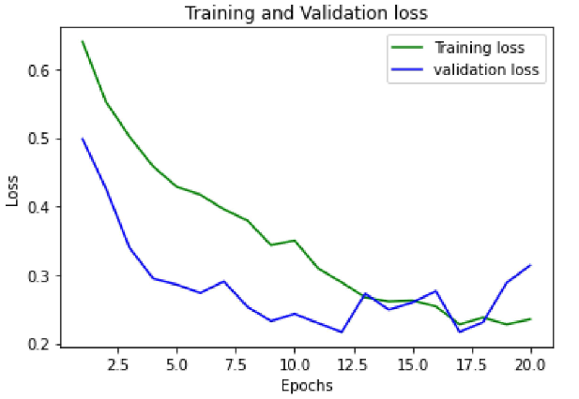
Training and Validation loss
20 Frames
30 Frames
40 Frames

Slide 28
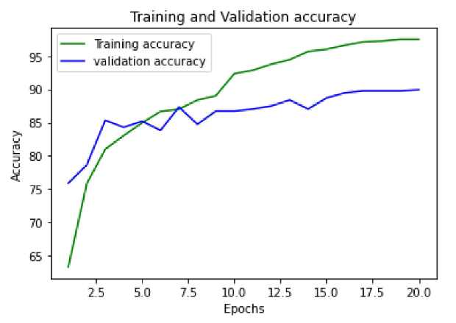
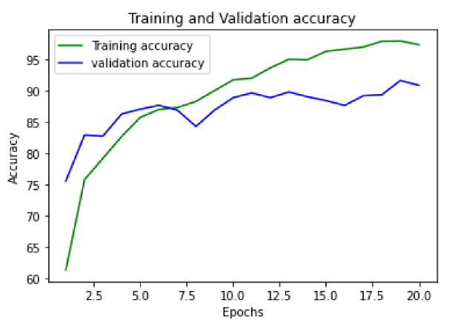
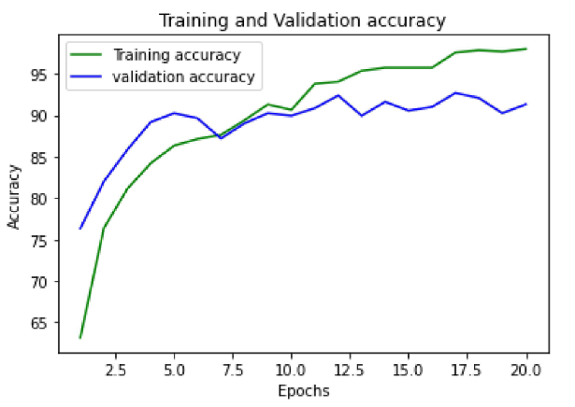
Training and Validation Accuracy
20 Frames
30 Frames
40 Frames

Slide 29
REFERENCES
[1] Yuezun Li, Ming-Ching Chang and Siwei Lyu “Exposing AI
Created Fake Videos by Detecting Eye Blinking” in arxiv.
[2] T Drutarovsky and A Fogelton “Eye blink detecction using variance of motion vectors” in ECCV, pages 436–448, 2014.
[3] David Guera and Edward J.Delp “Deepfake video detection using recurrent neural network” in Ieeexplore, 2018.
[4] https://github.com/yuezunli/celeb-deepfakeforensics
[5] https://www.kaggle.com/c/deepfake-detection-challenge/data

Slide 30
THANK YOU

